Slide 1



E-PLANET
Challenges and lessons learned from EAZK experience
&
ePLANET methodology to estimate the PV potential on a rooftops
Tomáš Perutka
Brussels
10th June 2024
Energetická agentura Zlínského kraje, o.p.s.

Slide 2
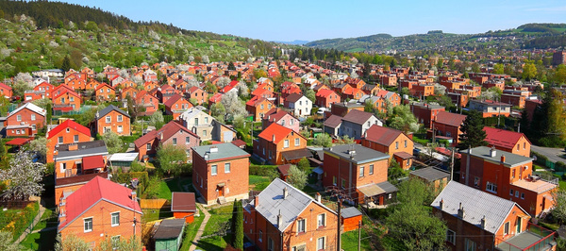

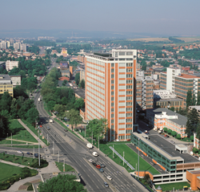

ePLANET & the Zlín Region
Day to day addressed approach to municipalities
Independent advisory to municipalities
Tool for data governance and sharing
Notes:
The Zlín Region consists of more than 300 municipalities, from which the vast majority don´t develop their energy transition plan out of various reasons. The most common ones are lack of financial sources and personal capacities to do so. Despite this, we must admit the awareness on the needs to plan energy transition measures has increased considerably. EAZK is playing the leading role in this due to its day to day addressed approach to municipalities in planning and implementing their energy transition measures so that they were aligned to the goals in energy transition plans on both national and regional level.
Supervision of a regional technician could help improve the development of energy transition plans in small municipalities. The key thing is such a supervisor was independent on any company trading with energy related goods and services, therefore, the regions or their organisations should take this role.
Having a tool that helps with data governance and sharing is necessary, although we still need to distinguish data governance from data sharing. To have a data governance tool is absolutely necessary and without such a tool in these days it is unimaginable to plan, implement or assess any energy transition plans or even energy transition measures effectively. A data sharing tool is also important, it helps to promote and process implementation of energy transition plans and measures in many ways including inspiring some municipalities by showcasing the experience and results from other areas, benchmarking which can initiate a healthy competition among municipalities etc. Some GDPR related issues are necessary to take into consideration just like anonymisation of data etc. The important thing related to the work with data sharing tools is also the ability of users to understand all the presented data correctly, which should be also the role of the regional technicians mentioned in the answer on previous question.

Slide 3
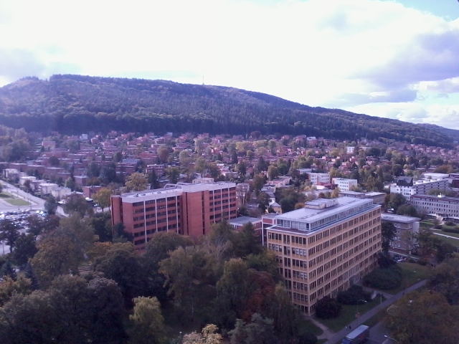
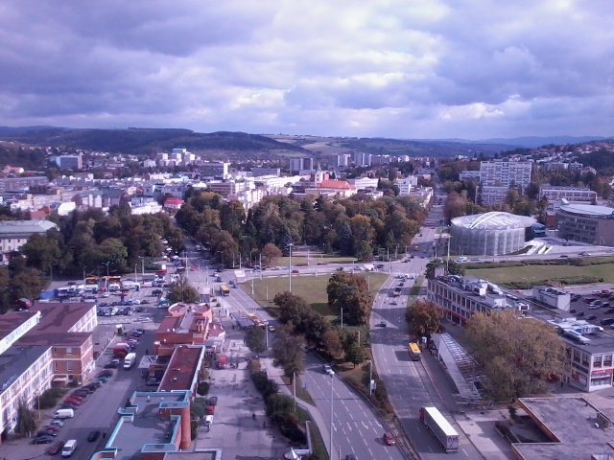


ePLANET & the Zlín Region
Improvements to encourage the development of energy transition policies
Meeting targets on EU level
– reduction of emissions by 55 % by 2030
Notes:
Majority of municipalities in our region are small municipalities with a critical lack of experienced stuff to be able to administrate and follow up all the necessary procedures which must be followed for example when applying to CoM initiative. If they decide to submit, they need to hire external company anyway to develop required plans and tables which, at the end of the days, seem for them to be too costly and demanding to deal with it. So, definitely, a tailored and user-friendly support from higher level should be improved for small municipalities to feel more encouraged to develop complex transition policies within their areas.
Municipalities need to reduce emissions by 55 % by 2030. A close cooperation with citizens as well as with private sector within the area of the municipalities seems to be a critical point to achieve such ambitious goals. Besides leading by examples (best practices), which need to be not only environmentally friendly but also economically sustainable, the municipalities will need to increase the effort in developing common project with citizens and private sector, for example local multilateral energy communities.

Slide 4
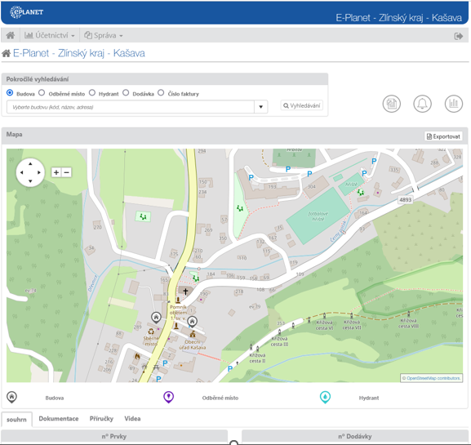
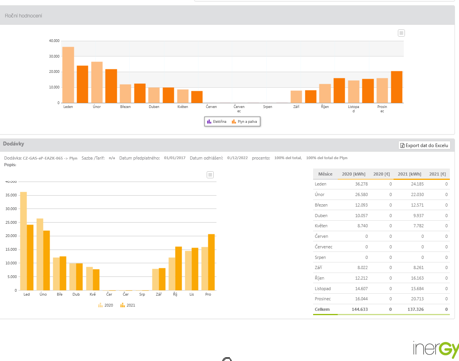
ePLANET Platform in the Zlín Region
Identification of buildings including their energy consumption
Example of energy management visualisation in UC 2 - Performance of public building stock
(monthly and yearly consumption)
Notes:
Energy management was introduced to all building belonging to the Zlín Region in 2008, so we dispose with a huge database with a long history. In the course of time objects from municipal level are being included into the monitoring system as well. Currently we have up to 80 municipalities included.

Slide 5
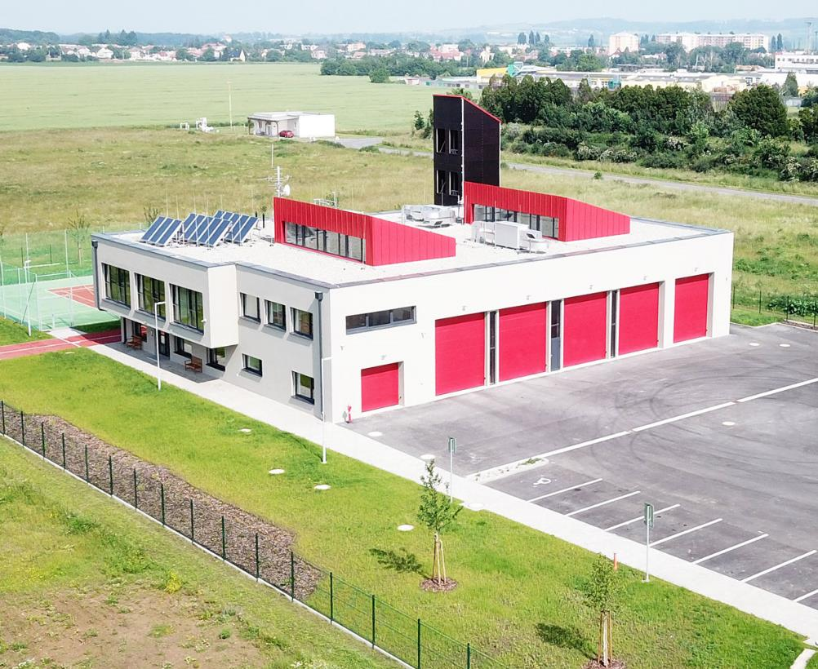
ePLANET Platform in the Zlín Region
Energy management
Notes:
The data are collected manually by designated persons. Verification on data input by EAZK staff is very important. We use feedback to optimize operations.

Slide 6
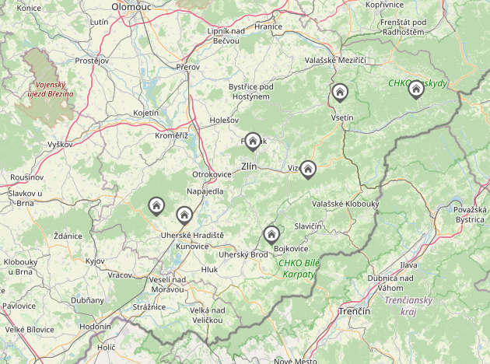
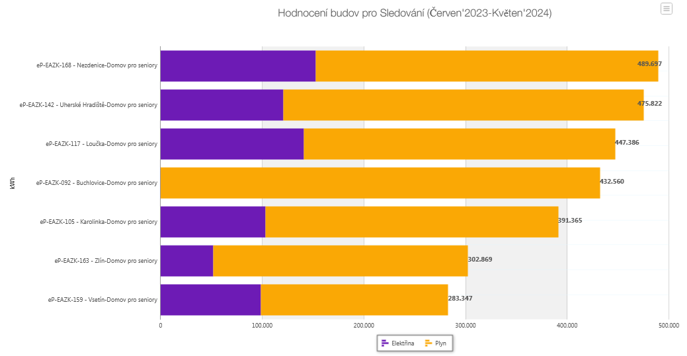
ePLANET Platform in the Zlín Region
Benchmarking of energy consumption within
UC 2 Performance of public building stock
Example of regional buildings benchmarking – care homes (old people’s homes)
Notes:
Electricity x gas
Filtering buildings upon purpose, the operator, the owner etc.

Slide 7
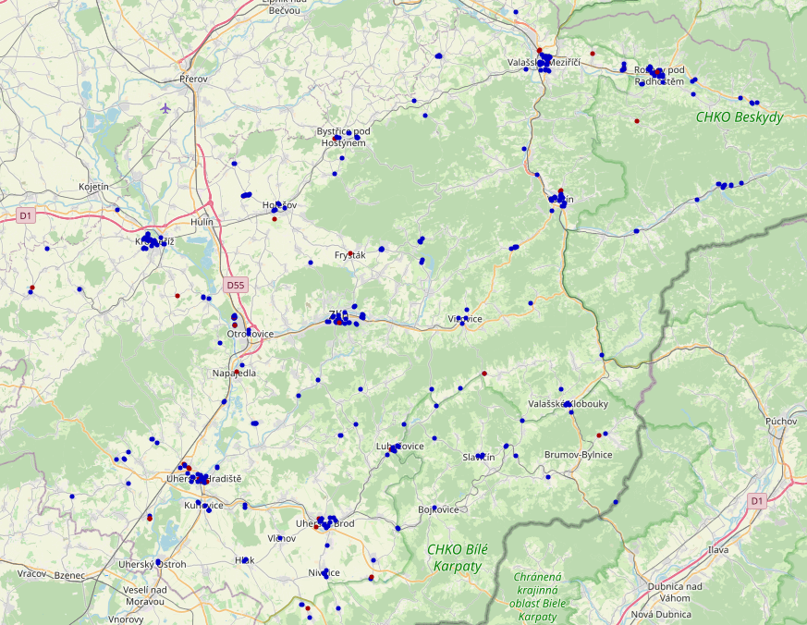
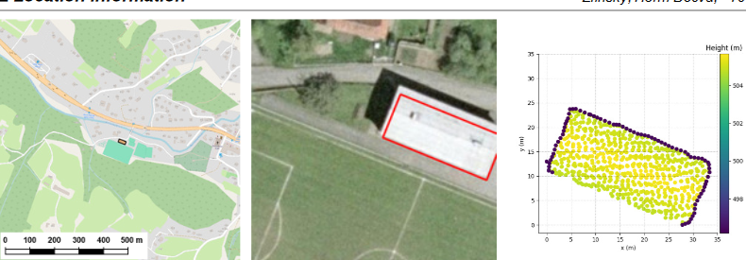
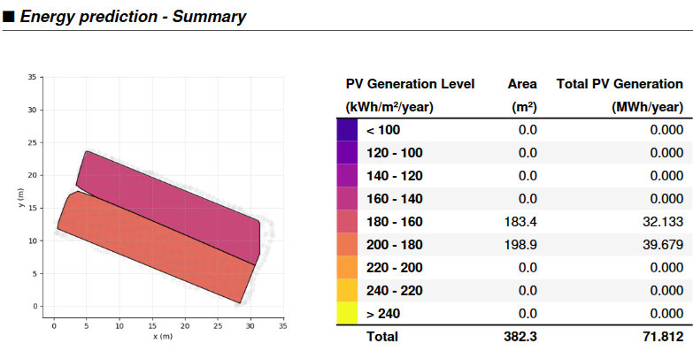
ePLANET Platform in the Zlín Region
Use Case 4 – PV potential analysis
Notes:
For all buildings that are available in the database for UC 2 performance building stock, the potential for installing PV power plants on their roofs was also determined. Two important external sources of data are crucial in this process to determine the potential of the roofs.
Solar radiation maps
LIDAR technology (Light Detection And Ranging) was used
PV potential for almost 400 buildings can be seen in Use Case 4 – PV potential analysis.

Slide 8
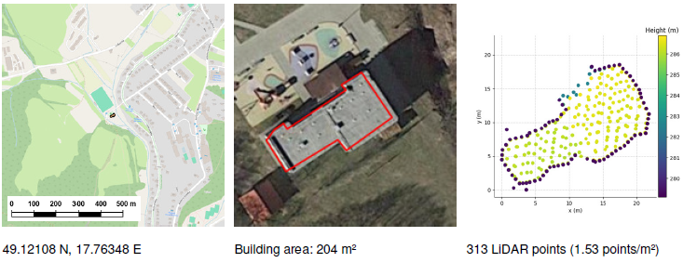
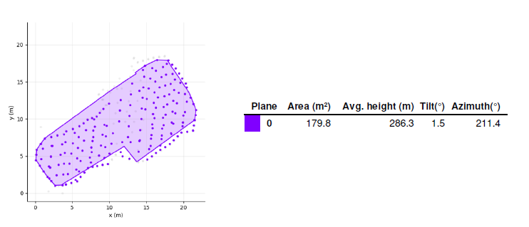
ePLANET Platform in the Zlín Region
Use Case 4 – PV potential analysis
Basic info
Roof analysis
Notes:
The tool, or rather the calculations, also include different types and inclinations of roofs.

Slide 9
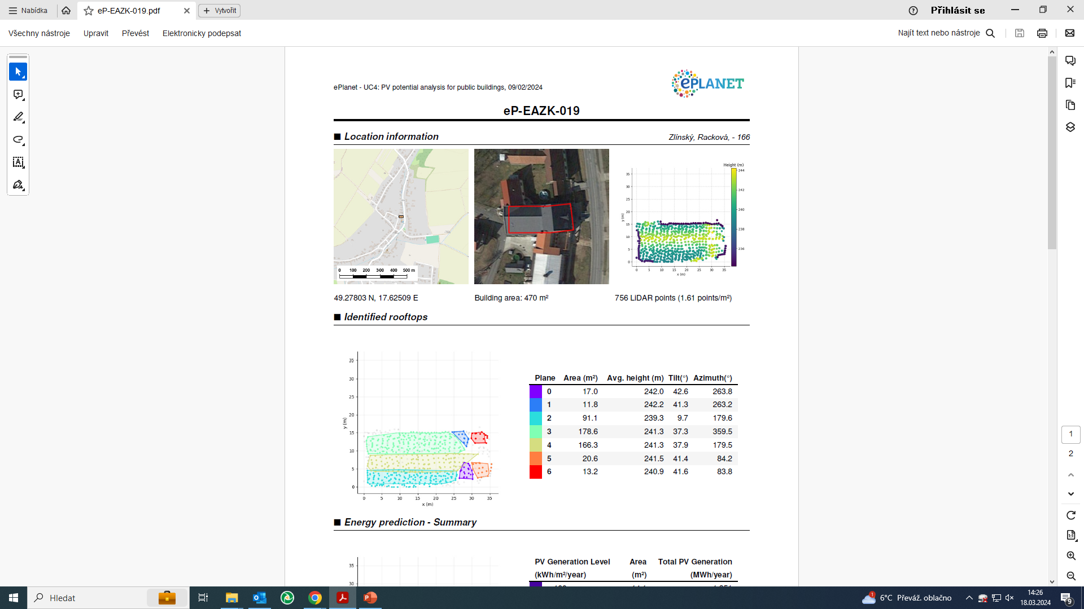
Example of PV potential analysis on the concrete roof of the building
ePLANET Platform in the Zlín Region
Use Case 4 – PV potential analysis
Step 2 - Roof analysis
Step 1 - Basic info
Notes:
This is, for example the example of PV potential analysis of split gable roofs.
Besides the basic info step one, in step two we can identify area, avg. height, tilt (inclination) and azimuth for each specific part of the roof.

Slide 10
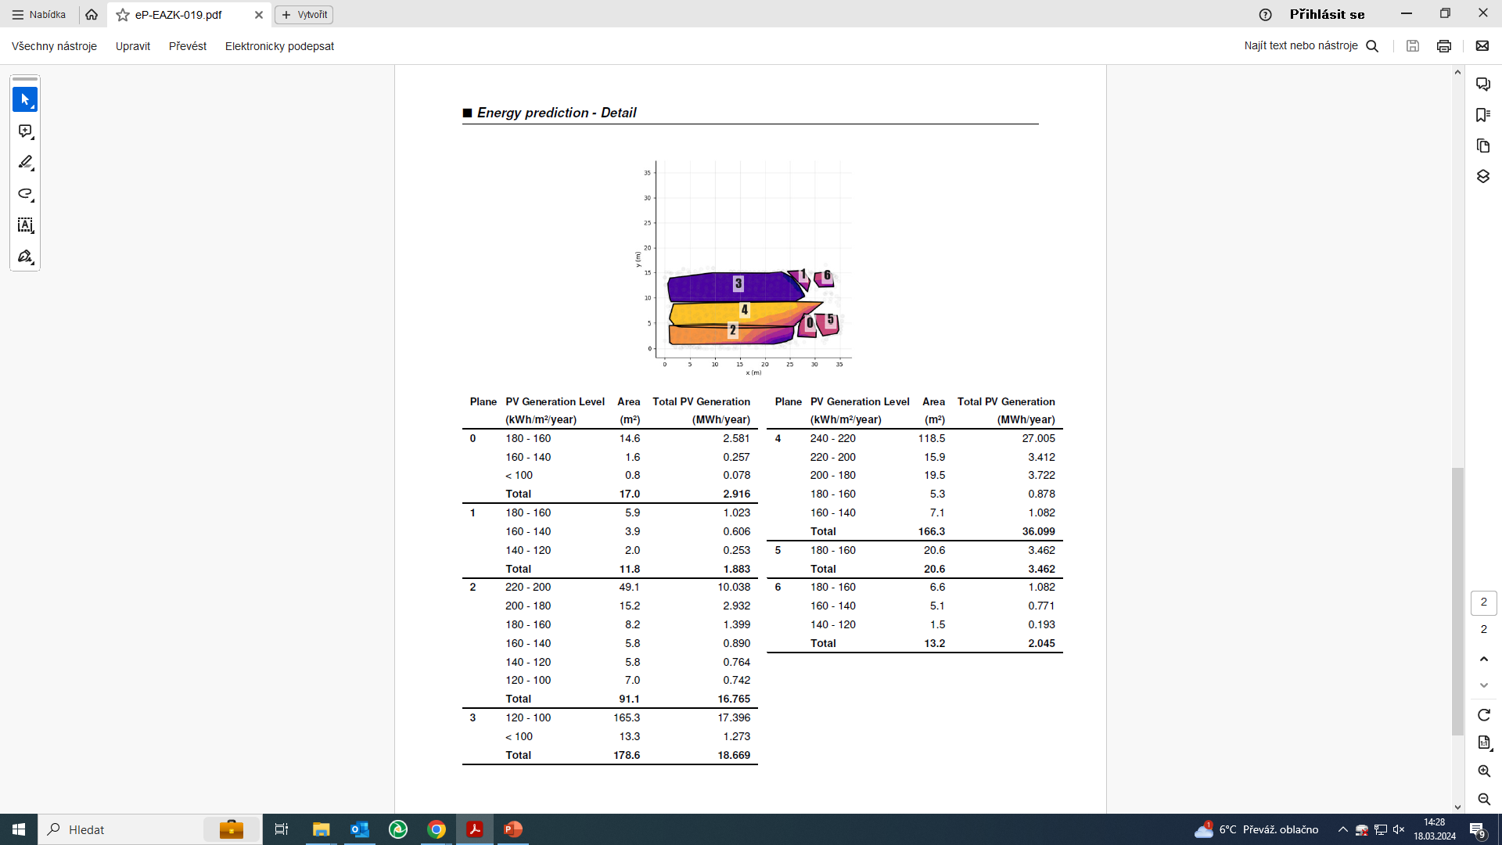
step 3 – detailed prediction of energy production
ePLANET Platform in the Zlín Region
Use Case 4 – PV potential analysis
Notes:
Upon the information from step two the tool calculates total PV generation potential for each PV generation level (area) – so, actually, one roof has six several types of surfaces from the PV energy generation point of view and each one has its potential calculated.

Slide 11
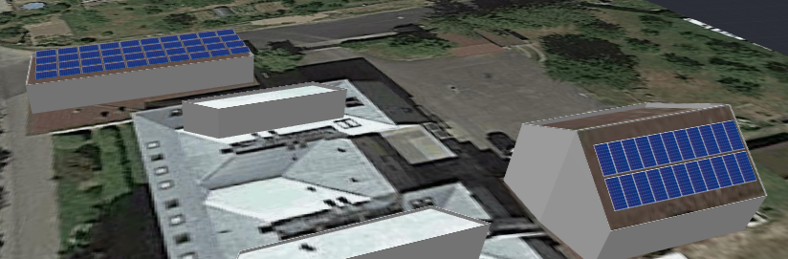
ePLANET Platform in the Zlín Region
step 4 – visualisation
step 5 – application
Notes:
Po evaluaci nakonec uděláme vizualizace pro žadatele o dotace.

