Slide 1


ePlanet Final Event
How to accelerate the deployment of energy transition to fulfil the 2030 and 2050 Energy goals?
10th of June 2024, Brussels

Slide 2
Implementing the Energy Efficiency First Principle in Regional Planning

Slide 3
Energy efficiency implementation: a key to the energy transition
New climate objectives by 2030 and 2050 led to update accordingly the Energy Efficiency Directive (EED):
New EE 2030 target: 11.7% of energy consumption reduction across the EU (in comparison to 2% to 2020)
Doubling of the energy savings objective by 2030
The implementation of this particular objective will be ensured by the local stakeholders at the end of the day, consistently to the national contributions defined in the NECPs (final update by the end of June).

Slide 4
New provision is the introduction of the Energy Efficiency First Principle (Article 3) aiming at streamlining energy efficiency in planning and related decision-making in investment.
A key element for the proper implementation of energy efficiency
The Regio1st aims at proposing concrete tools and activities to regional and local authorities to successfully implement energy efficiency through the inclusion of the EE1st into their climate and energy plans.

Slide 5

Objectives
Provide decision-support for regional authorities to apply the EE1st principle in their energy-related planning practices
Establish a community of practice for EE1st to ensure political commitment and societal acceptance through co-development of energy related scenarios
Support the introduction or strengthening of EE1st in the revision of National Energy and Climate Plans, Regional Operational Programs and foster the enforcement of Multilevel Climate and Energy Dialogues

Slide 6
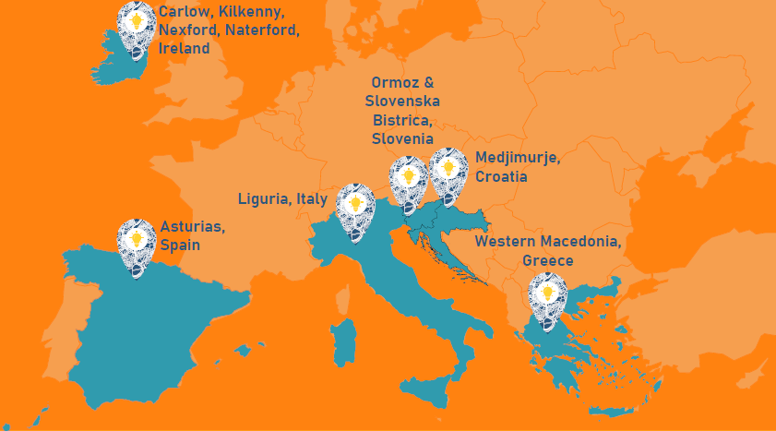
Scope
Regio1st directly addresses six regions, and indirectly targets 100 additional regional and 120 additional local agencies and authorities through knowledge exchange and capacity building.
These regions have been chosen since they are in delicate planning phases and are facing various investment choices. They will implement and test the Regio1st framework and will then showcase to other regions how they embedded the EE1st principle.

Slide 7
Tools and activities developed by the project
The Regio1st Planning Framework
The Mentoring Program
The different events fostering knowledge-sharing and enforcement of multilevel governance

Slide 8

The Regio1st Planning Framework
The REGIO1st Planning Framework provides a comprehensive, structured approach for regional energy planners in Europe to develop and implement sustainable, cost-effective energy strategies in line with the EE1st principle.

Slide 9

The mentoring program
What is it ?
The program is a set of online mentoring sessions for other regional and local authorities.
Registered participants will be gathered according to their local context as well as specific needs and challenges.
3 main topics will be available in the sessions: Use and adaptation of REGIO1st tool, Guidance on multilevel governance for EE1st implementation, Coal Regions in Transition Platform
How to register ?
In a couple of weeks, you will be able to read the application packs describing the program, on the project’s website, and an application form will be made available
Find out more on the project’s website:

Slide 10
Events and activities
Six National workshops, organised by the partner regions, to promote the development of a national multilevel dialogue for EE1st, in line with the Governance Regulation
Four EU roundtables in Brussels, to promote the introduction of EE1st into Covenant of the Mayors and Committee of the Regions policies and related documents
Six Online policy roundtables, which are a direct dialogue between local/regional experts and EU representatives on the practical implications of the EE1st principle

Slide 11
Partners

